Slide 1
NP-Completeness
A.Kannan

Slide 2
Complexity Theory
The complexity theory deals with the study of what can/cannot be done well via purely mechanical means.
A problem is solvable if there exists an algorithm that solves it (provides the correct answer for each instance).
"Order" is something we use to describe an upper bound upon the size of something else (in our case, time, but it can apply to almost anything).

Slide 3
Time Complexity
    Order of an Algorithm: The maximum number of steps required to find the answer to any instance of size n, for any arbitrary value of n.
    For example, if an algorithm requires at most 6n²+3n–6 steps on any instance of size n, we say it is "order n²" or, simply, O(n²).
    Complexity definitions:
Big-Oh
Big-Theta
Big - Omega

Slide 4
Class of “P” Problems
Class P consists of (decision) problems that are solvable in polynomial time.
Polynomial-time algorithms
  Worst-case running time is O(n^{k}), for some constant k
Examples of polynomial time:
  O(n²), O(n³), O(1), O(n lg n)
Examples of non-polynomial time:
  O(2^{n}), O(n^{n}), O(n!)

Slide 5
Complexity Analysis
  A Polynomial time problem (P) can be solved quickly (i.e., in close to linear time, or at least a time that is some small polynomial function of the input size).
NP-completeness problems can not be solved quickly.
The algorithmic complexity of a computation is some measure of how difficult is to perform the computation (i.e., specific to an algorithm).

Slide 6
Big Oh (O)
f(n)= O(g(n)) iff there exist positive constants c and n0 such that f(n) ≤ cg(n) for all n ≥ n0.
O-notation to gives an upper bound on a function.

Slide 7
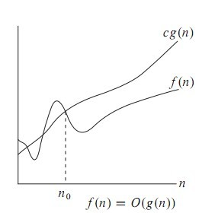
Big Oh (O)

Slide 8
Omega Notation
Big oh provides an asymptotic upper bound on a function.
Omega provides an asymptotic lower bound on a function.

Slide 9

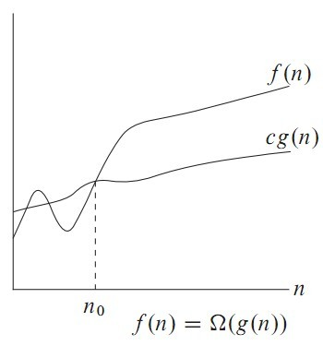
Omega Notation Contd..

Slide 10

Theta Notation
Theta notation is used when function f can be bounded both from above and below by the same function g.

Slide 11
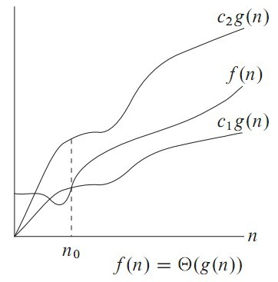
Theta Notation

Slide 12
The class P
The class P consists of those problems that are solvable in polynomial time.
More specifically, they are problems that can be solved in time O(n^{k}) for some constant k, where n is the size of the input to the problem.
The key is that n is the size of input.

Slide 13
NP
NP is not the same as non-polynomial complexity/running time. NP does not stand for non polynomial.
NP = Non-Deterministic polynomial time
NP means verifiable in polynomial time
Verifiable?
  If we are somehow given a ‘certificate’ of a solution, then we can verify the legitimacy in polynomial time.

Slide 14
Hamiltonian cycles
Determining whether a directed graph has a Hamiltonian cycle does not have a polynomial time algorithm (yet!).
However if someone was to give you a sequence of vertices, determining whether or not that sequence forms a Hamiltonian cycle can be done in polynomial time.
Therefore, Hamiltonian cycles are in NP.

Slide 15
SAT
A boolean formula is satisfiable if there exists, some assignment of the values 0 and 1 to its variables that causes it to evaluate
to 1.
CNF – Conjunctive Normal Form. ANDing of clauses of ORs.

Slide 16
2-CNF SAT
Each “OR” operation has two arguments that are either variables or negation of variables.
The problem in 2 CNF SAT is to find true/false(0 or 1) assignments to the variables in order to make the entire formula true.
Any of the OR clauses can be converted to implication clauses.
(¬x∨y)∧(¬y∨z)∧(x∨¬z)∧(z∨y)

Slide 17
A → B is equivalent to 7A v B.
7x v y is given, it is equivalent to x→y.

Slide 18
2-SAT is in P
Create the implication graph
¬x
y
x
¬y
¬z
z

Slide 19


Satisfiability via path finding
If there is a path from
And if there is a path from
Then FAIL!
How to find paths in graphs?
  DFS/BFS and modifications thereof

Slide 20
3 CNF SAT (3 SAT)
Not so easy anymore.
Implication graph cannot be constructed
No known polynomial time algorithm.
Is it NP?
  If someone gives you a solution how long does it take to verify it?
  Make one pass through the formula and check
This is an NP problem.

Slide 21
P is a subset of NP
Since it takes polynomial time to run the program, just run the program and get a solution
But is NP a subset of P?
No one knows if P = NP or not
Solve for a million dollars!
  http://www.claymath.org/millennium-problems
  The Poincare conjecture is solved today

Slide 22
What is not in NP?
Undecidable problems
  Given a polynomial with integer coefficients, does it have integer roots
  Hilbert’s nth problem
  Impossible to check for all the integers
  Even a non-deterministic TM has to have a finite number of states!
Tautology
  A boolean formula that is true for all possible assignments
  Here just one ‘verifier’ will not work. You have to try all possible values

Slide 23
Reducibility
A problem Q can be reduced to another problem Q’ if any instance of Q can be “easily rephrased” as an instance of Q’, the solution to which provides a solution to the instance of Q.
Is a linear equation reducible to a quadratic equation?
  Sure! Let coefficient of the square term be 0

Slide 24
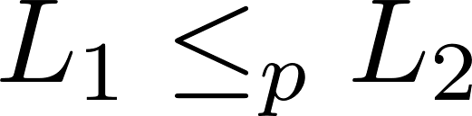
NP - hard
What are the hardest problems in NP?
That notation means that L₁ is reducible in polynomial time to L₂ .
The less than symbol basically means that the time taken to solve L₁ is no worse than a polynomial factor away from the time taken to solve L₂.

Slide 25
NP-hard
A problem (a language) is said to NP-hard if every problem in NP can be reduced to a problem that can be solved in polynomial time.

Slide 26
NP Complete problems/languages
Need to be in NP
Need to be in NP-Hard
If both are satisfied then it is an NP complete problem
Reducibility is a transitive relation.
If we know a single problem in NP-Complete that helps when we are asked to prove some other problem is NP-Complete.
Assume problem P is NP Complete
All NP problems are reducible to this problem
Now given a different problem P’
If we show P reducible to P’
Then by transitivity all NP problems are reducible to P’.

Slide 27
What is in NP-Complete
We will axiomatically state that the following problems are NP-Complete.
SAT – Given any boolean formula, is there some assignment of values to the variables so that the formula has a true value.
3-CNF SAT
Actually any boolean formula can be reduced to 3-CNF form.

Slide 28
An example reduction
CLIQUE problem
A clique in an undirected graph is a subset of vertices such that each pair is connected by an edge.
We want to take a problem instance in 3-CNF SAT and convert it to CLIQUE finding.

Slide 29
Reducing 3CNF SAT to CLIQUE
Given – A boolean formula in 3 CNF SAT
Goal – Produce a graph (in polynomial time) such that
We will construct a graph where satisfying formula with k clauses is equivalent to finding a k vertex clique.

Slide 30
Clique Problem
A Clique is a subgraph of graph such that all vertcies in subgraph are completely connected with each other. Given a Graph, find if it can be divided into two Cliques.
Examples:
Input : G[][] = {{0, 1, 1, 0, 0}, {1, 0, 1, 1, 0}, {1, 1, 0, 0, 0}, {0, 1, 0, 0, 1}, {0, 0, 0, 1, 0}}; Output : Yes

Slide 31
Expained
A---------B--------D
$ * #
$ * #
$ * #
C E

Slide 32
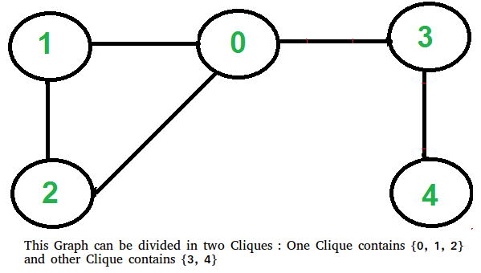
Cliques
Clique example

Slide 33
Decision problems versus optimization problems
Finding the maximum sized clique is an optimization problem.
But we can reduce it to a series of decision problems
  Can we find a clique of size 3 (why start at 3??)
  Can we find a clique of size 4
  Etc
In general in our study of NP etc, we will focus on decision problems.

Slide 34
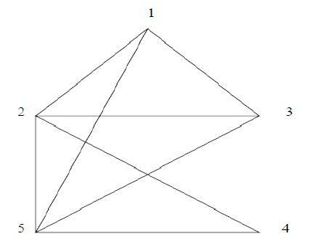
Clique Size

Slide 35
Clique Size Contd…
An example of clique, where 1,2,3,5 are connected and form a clique of size 4. The maximum clique problem is very important in bioinformatics, computer science and other fields. An algorithm has been designed for finding a maximum clique in a graph of any size.

Slide 36
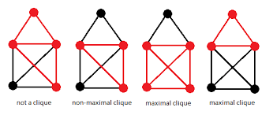
Cliques

Slide 37
Vertex cover problem
A vertex cover of an undirected graph G=(V,E) is a subset of vertices such that every edge is incident to at least one of the vertices.
A vertex-cover of an undirected graph G = (V, E) is a subset of vertices V' ⊆ V such that if edge (u, v) is an edge of G, then either u in V or v in V' or both.

Slide 38
Vertex Cover Problem Contd..
We’re typically interested in finding the minimum sized vertex cover.
To show vertex cover is NP-complete
What problem should we try to reduce to it
It sounds like the ‘reverse’ of CLIQUE
Reduction is done from CLIQUE to vertex cover

Slide 39
Vertex Cover Problem Contd..
Example
The set of edges of the given graph is −
{(1,6),(1,2),(1,4),(2,3),(2,4),(6,7),(4,7),(7,8),(3,8),(3,5),(8,5)}

Slide 40
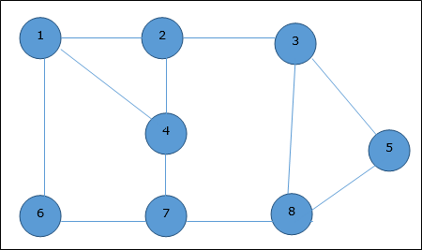
Vertex Cover Problem Contd..

Slide 41
Vertex Cover Problem Contd..
Now, we start by selecting an arbitrary edge (1,6). We eliminate all the edges, which are either incident to vertex 1 or 6 and we add edge (1,6) to cover.

Slide 42
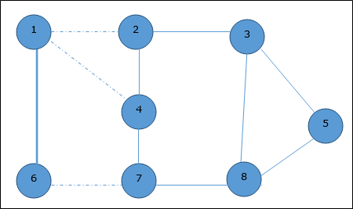
Vertex Cover Problem Contd..

Slide 43

Vertex Cover Problem Contd..
In the next step, we have chosen another edge (2,3) at random.

Slide 44
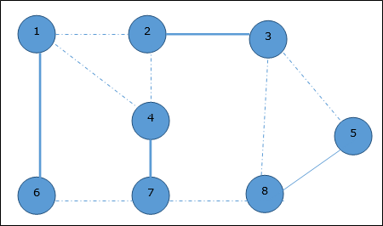
Vertex Cover Problem Contd..
Now we select another edge (4,7).

Slide 45

Vertex Cover Problem Contd..
We select another edge (8,5).
Hence, the vertex cover of this graph is {1,2,4,5}.

Slide 46
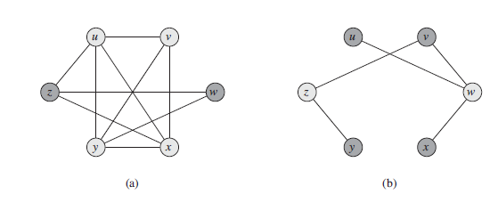

G’ = Complement
Of
G
G
Clique of size k in G exists iff a vertex cover of size |V| - k exists in G’ where G’ is the complement graph (vertices that had an edge between then in G do not have one in G’ and vice versa)

Slide 47
The original graph has a u,v,x,y CLIQUE. That is a clique of size 4.
The complement graph has a vertex cover of size 6 (number of vertices) – 4 (clique size). z,w is one such vertex cover.

Slide 48
Traveling Salesperson Problem
You have to visit n cities
You want to make the shortest trip
How could you do this?
What if you had a machine that could guess?

Slide 49
Non-deterministic polynomial time
Deterministic Polynomial Time: The TM takes at most O(n^{c}) steps to accept a string of length n
Non-deterministic Polynomial Time: The TM takes at most O(n^{c}) steps on each computation path to accept a string of length n.

Slide 50
The Class P and the Class NP
P = { L | L is accepted by a deterministic Turing Machine in polynomial time }
NP = { L | L is accepted by a non-deterministic Turing Machine in polynomial time }
They are sets of languages

Slide 51
Polynomial time reductions
PARTITION = { n₁,n₂,… n_{k} | we can split the integers into two sets which sum to half }
SUBSET-SUM = { <n₁,n₂,… n_{k},m> | there exists a subset which sums to m }
1) If I can solve SUBSET-SUM, how can I use that to solve an instance of PARTITION?
2) If I can solve PARTITION, how can I use that to solve an instance of SUBSET-SUM?

Slide 52
Partition
Partition problem is to determine whether a given set can be partitioned into two subsets such that the sum of elements in both subsets is the same.
Examples:
arr[] = {1, 5, 11, 5} Output: true The array can be partitioned as {1, 5, 5} and {11}
arr[] = {1, 5, 3} Output: false The array cannot be partitioned into equal sum sets.

Slide 53
Subset Sum
Given a set of non-negative integers, and a value sum, determine if there is a subset of the given set with sum equal to given sum.
Example:
Input: set[] = {3, 34, 4, 12, 5, 2}, sum = 9 Output: True There is a subset (4, 5) with sum 9. Input: set[] = {3, 34, 4, 12, 5, 2}, sum = 30 Output: False There is no subset that add up to 30.

Slide 54
Polynomial Reductions
1) Partition REDUCES to Subset-Sum
  Partition <_{p} Subset-Sum
2) Subset-Sum REDUCES to Partition
  Subset-Sum <_{p} Partition
Therefore they are equivalently hard

Slide 55
How long does the reduction take?
How could you take advantage of an exponential time reduction?

Slide 56
NP-Completeness
How would you define NP-Complete?
They are the “hardest” problems in NP
NP-Complete
P
NP

Slide 57
Definition of NP-Complete
Q is an NP-Complete problem if:
1) Q is in NP
2) every other NP problem polynomial time reducible to Q
Notes:
Informally describe this: picture of complexity classes

Slide 58
Cook-Levin Theorem (1971)
SAT is NP-Complete
If you want to see the proof it is Theorem 7.37 in Sipser (assigned reading!) or you can take CS 660 – Graduate Theory. You are not responsible for knowing the proof.
Notes:
If you want to see the proof it’s in Sipser (Thm 7.37) or CS660

Slide 59
NP-Complete
To prove a problem is NP-Complete show a polynomial time reduction from 3-SAT
Other NP-Complete Problems:
  PARTITION
  SUBSET-SUM
  CLIQUE
  HAMILTONIAN PATH (TSP)
  GRAPH COLORING

Slide 60
NP-Completeness Proof Method
To show that Q is NP-Complete:
1) Show that Q is in NP
2) Pick an instance, R, of your favorite NP-Complete problem (ex: Φ in 3-SAT)
3) Show a polynomial algorithm to transform R into an instance of Q

Slide 61
Example: Clique
CLIQUE = { <G,k> | G is a graph with a clique of size k }
A clique is a subset of vertices that are all connected
Why is CLIQUE in NP?

Slide 62
Reduce 3-SAT to Clique
Pick an instance of 3-SAT, Φ, with k clauses
Make a vertex for each literal
Connect each vertex to the literals in other clauses that are not the negation
Any k-clique in this graph corresponds to a satisfying assignment

Slide 63
Conclusions
NP-Complete problems are the HARDEST problems in NP
The reductions MUST take polynomial time
Reductions are hard and take practice
Always start with an instance of the known NP-Complete problem

